Slide 1
ETL & Meta-data
Group No: 1
Nishanth Shanmugam
Shweta Suman
Prachi Agrawal
K. Siddharth
Parvesh Thapa

Slide 2
ETL : Overview
“A data warehouse is a system that extracts, cleans, conforms, and delivers source data into a dimensional data store and then supports and implements querying and analysis for the purpose of decision making.” Source: Ralph Kimball, Joe Caserta: The Data Warehouse ETL Toolkit; Wiley 2004
The most visible part is “querying and analysis”.
The most complex and time consuming part is “extracts, cleans, conforms, and delivers”.

Slide 3
Extraction Transformation Loading
The most complex and time consuming part is “extracts, cleans, conforms, and delivers”
How complex is it?
70-80% of BI (DI or DW) project is reliable ETL process

Slide 4
Why ETL?
Companies need a way to analyse their data for critical business decisions.
Transactional Database can’t answer complex business questions.
Data Warehouse – provides a common data repository.
ETL provides a method of moving the data from various source into a data warehouse.

Slide 5
EXTRACTION
Data extraction from various sources(heterogeneous system)
Different data representation, formats:
E.g: RDBMS, Flat files
Data to be converted to a common format for transformation process.
Extracts the data from data sources and keeps it in stage.
Data comes from an operational source or achieve system which are the primary sources.
It minimizes impact on production data sources.

Slide 6
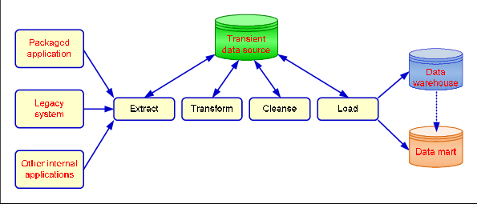

Slide 7
Transformation:
Various sets of business rules and functions are applied on extracted data before the data gets loaded to a data warehouse
Steps involved:
Selecting columns to load
Cleansing data to remove duplicates & enforce consistency
Translating coded values
Encoding free form values
Deriving new calculated value
Joining together data from multiple sources

Slide 8
Transformation Flow
From an architectural perspective, you can transform your data in two ways:
Multi stage data transformation
Pipelines data transformation

Slide 9
LOADING PROCESS:
This is the final step in the ETL process.
In this step, the extracted data and transformed data is loaded to the target database.
In order to make data load efficient, it is necessary to index the database
In case of load failure, recover mechanisms should be configured to restart from the point of failure without data integrity loss.

Slide 10
TYPES OF LOADING:
Initial Load — populating all the Data Warehouse tables
Incremental Load — applying ongoing changes as when needed periodically.
Full Refresh —erasing the contents of one or more tables and reloading with fresh data.

Slide 11
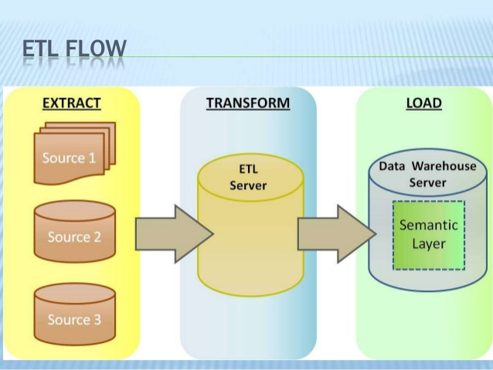

Slide 12
Metadata in ETL
Metadata in ETL contains data about Data:
Dimension
Attribute
Fact
Measure

Slide 13
Metadata
Metadata is more comprehensive and transcends the data.
Metadata provide the format and name of data items
It actually provides the context in which the data element exists.
Provides information such as the domain of possible values.
The relation that data element has to others.
The data’s business rules
And even the origin of data.

Slide 14
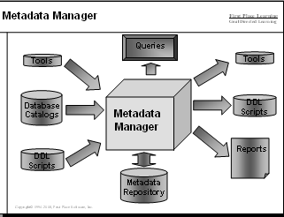
Importance of Metadata
Metadata establish the context of the warehouse data
Metadata facilitate the analysis process
Metadata are a form of Audit trail for Data Transformation
Metadata improves or maintain Data Quality

Slide 15
ANY QUESTIONS ?

Slide 16
THANK YOU

